Slide 1
The NDSA Levels of Digital Preservation
Explanation and Uses
Archiving 2013: 4/5/2013
Washington, DC
Jefferson Bailey, Metropolitan New York Library Council (METRO)
Andrea Goethals, Harvard Library
Trevor Owens, Library of Congress
Megan Phillips, National Archives and Records Administration

Slide 2
What I’ll cover
Background
Levels of Digital Preservation, v.1
Uses
How you can help

Slide 3
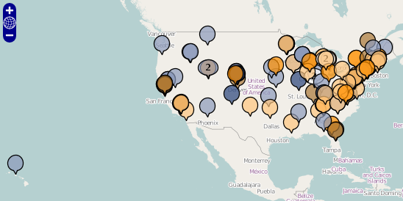
NDSA
Geographically diverse

Slide 4
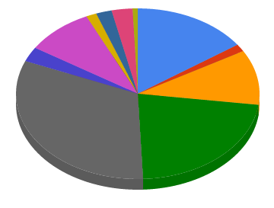
NDSA
Public Media
Diverse institutional types
Museum
Public Library
Law
Professional
Association
Consortia
U.S. Fed. Govt.
Nonprofit
Commercial
Academic
State & Local Government

Slide 5
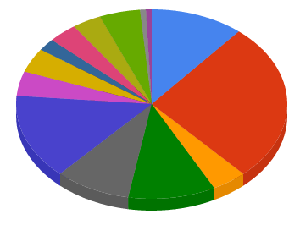
NDSA
Diverse in focus
Outreach
Web Archives
Distributed Storage
Innovation
Standards / Best Practices
Government Information
A/V
Legal Issues
Sustainability
Text & Image
Scientific Data
Education & Training
Tools & Infrastructure
Geospatial Data

Slide 6





NDSA
Diverse working groups
Content
Standards & Practices
Outreach
Innovation
Infrastructure

Slide 7
Common Need
Content
Standards & Practices
Outreach
Levels of Digital Preservation
Innovation
Infrastructure

Slide 8
Common Need
Simple, practical, documented levels of preservation services reflecting best practices, broadly useful
For those just starting out & those with mature programs
Independent of formats, storage systems
Useful to educators & implementers

Slide 9
Niche
Personal Archiving Advice
Levels of Digital Preservation
Formal Certifications & Audits
…
…

Slide 10
Levels of Digital Preservation, v1
 | Level 1 ↓ | Level 2 ↓ | Level 3 ↓ | Level 4 ↓
Category 1 →
Category 2 →
Category 3 →
Category 4 →
Category 5 →

Slide 11
Levels of Digital Preservation, v1
 | Level 1 ↓ | Level 2 ↓ | Level 3 ↓ | Level 4 ↓
Category 1 → | Level 1 Actions for Category 1 | Level 2 Actions for Category 1 | … | …
Category 2 → | Level 1 Actions for Category 2 | Level 2 Actions for Category 2 | … | …
Category 3 → | … | … | … | …
Category 4 → | … | … | … | …
Category 5 → | … | … | … | …

Slide 12
Levels of Digital Preservation, v1
 | Level 1 ↓ | Level 2 ↓ | Level 3 ↓ | Level 4 ↓
Category 1 →
Category 2 →
Category 3 →
Category 4 →
Category 5 →
Bit-level Protection
Longer-term Usability

Slide 13
Levels of Digital Preservation, v1
 | Level 1 (Protect your data) | Level 2 (Know your data) | Level 3 (Monitor your data) | Level 4 (Repair your data)
Storage and Geographic Location | - Two complete copies that are not collocated - For data on heterogeneous media (optical discs, hard drives, etc.) get the content off the medium and into your storage system | - At least three complete copies - At least one copy in a different geographic location - Document your storage system(s) and storage media and what you need to use them | - At least one copy in a geographic location with a different disaster threat - Obsolescence monitoring process for your storage system(s) and media | - At least three copies in geographic locations with different disaster threats - Have a comprehensive plan in place that will keep files and metadata on currently accessible media or systems
File Fixity and Data Integrity | - Check file fixity on ingest if it has been provided with the content - Create fixity info if it wasn’t provided with the content | - Check fixity on all ingests - Use write-blockers when working with original media - Virus-check high risk content | - Check fixity of content at fixed intervals - Maintain logs of fixity info; supply audit on demand - Ability to detect corrupt data - Virus-check all content | - Check fixity of all content in response to specific events or activities - Ability to replace/repair corrupted data - Ensure no one person has write access to all copies
Information Security | - Identify who has read, write, move and delete authorization to individual files - Restrict who has those authorizations to individual files | - Document access restrictions for content | - Maintain logs of who performed what actions on files, including deletions and preservation actions | - Perform audit of logs
Metadata | - Inventory of content and its storage location - Ensure backup and non-collocation of inventory | - Store administrative metadata - Store transformative metadata and log events | - Store standard technical and descriptive metadata | - Store standard preservation metadata
File Formats | - When you can give input into the creation of digital files encourage use of a limited set of known open formats and codecs | - Inventory of file formats in use | - Monitor file format obsolescence issues | - Perform format migrations, emulation and similar activities as needed

Slide 14
Storage and Geographic Location
Level 1 Protect your data | Level 2 Know your data | Level 3 Monitor your data | Level 4 Repair your data
Two complete copies that are not collocated For data on heterogeneous media (optical discs, hard drives, etc.) get the content off the medium and into your storage system | At least three complete copies At least one copy in a different geographic location Document your storage systems(s) and storage media and what you need to use them | At least one copy in a geographic location with a different disaster threat Obsolescence monitoring for your storage system(s) and media | At least three copies in geographic locations with different disaster threats Have a comprehensive plan in place that will keep files and metadata on currently accessible media or systems

Slide 15
File Fixity and Data Integrity
Level 1 Protect your data | Level 2 Know your data | Level 3 Monitor your data | Level 4 Repair your data
Check file fixity on ingest if it has been provided with the content Create fixity info if it wasn’t provided with the content | Check fixity on all ingests Use write-blockers when working with original media Virus-check high risk content | Check fixity of content at fixed intervals Maintain logs of fixity info; supply audit on demand Ability to detect corrupt data Virus-check all content | Check fixity of all content in response to specific events or activities Ability to replace/repair corrupted data Ensure no one person has write access to all copies

Slide 16
Information Security
Level 1 Protect your data | Level 2 Know your data | Level 3 Monitor your data | Level 4 Repair your data
Identify who has read, write, move and delete authorization to individual files Restrict who has those authorizations to individual files | Document access restrictions for content | Maintain logs of who performed what actions on files, including deletions and preservation actions | Perform audit of logs

Slide 17
Metadata
Level 1 Protect your data | Level 2 Know your data | Level 3 Monitor your data | Level 4 Repair your data
Inventory of content and its storage location Ensure backup and non-collocation of inventory | Store administrative metadata Store transformative metadata and log events | Store standards technical and descriptive metadata | Store standard preservation metadata

Slide 18
File Formats
Level 1 Protect your data | Level 2 Know your data | Level 3 Monitor your data | Level 4 Repair your data
When you can give input into the creation of digital files, encourage use of a limited set of known open formats and codecs | Inventory of file formats in use | Monitor file format obsolescence issues | Perform format migrations, emulation and similar activities as needed

Slide 19
Some Uses
Identify community consensus on best practices
Preservation service choices
Assessments – how do we compare with best practices?
What should we improve next?
Where do we excel?
How will we improve after project X?
How have we improved over time?

Slide 20
Self-assessment example
= satisfied with implementation
= implemented but could be improved
= will be satisfied with implementation
after current enhancement project
= not implemented
 | Level One | Level Two | Level Three | Level Four
Storage & Geographic Location
File Fixity and Data Integrity
Information Security
Metadata
File Formats

Slide 21
How you can help: provide feedback!
Revisions will continue until the Levels stabilize on a broad professional consensus.
Comments received by 8/31/2013 can affect the next revision
Send comments by e-mailing the authors at the addresses listed in the paper or at http://digitalpreservation.gov/ndsa/activities/levels.html
Next steps
Thank you!

